Slide 1
PyBullet Camera
computeViewMatrix

Slide 2
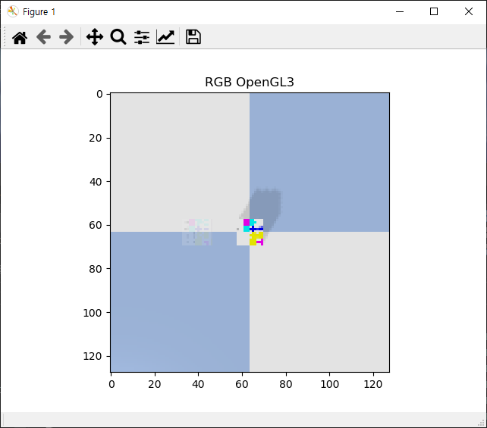
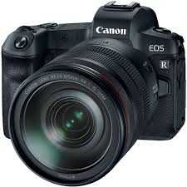
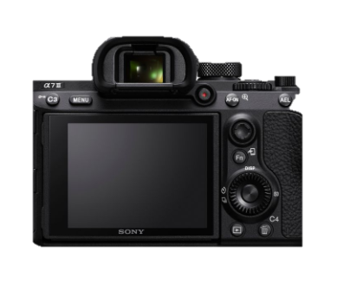
computeViewMatrix( cameraEyePosition,cameraTargetPosition,cameraUpVector)
cameraUpVector = [1,0,0]
빨간색=x축, 초록색=y축

Slide 3
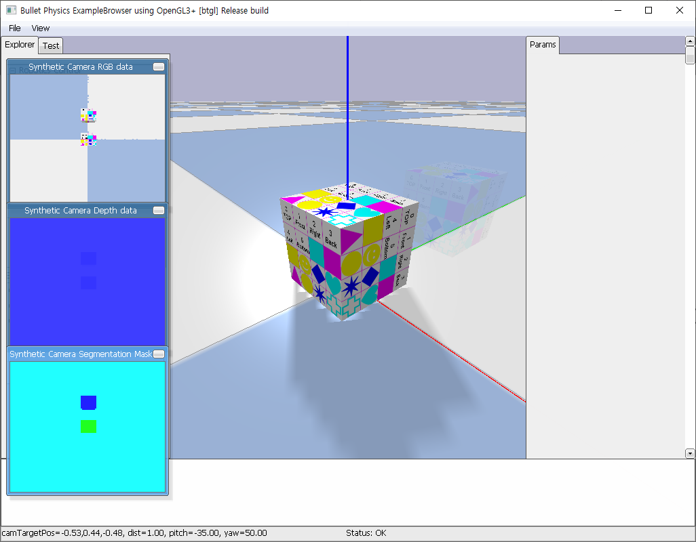
cameraUpVector 비교
p.loadURDF('cube_small.urdf', basePosition=[0.0, 0.0, 0.025])
cube_trans = p.loadURDF('cube_small.urdf', basePosition=[0.0, 0.1, 0.025])
p.changeVisualShape(cube_trans, -1, rgbaColor=[1, 1, 1, 0.1])
view_matrix = p.computeViewMatrix([0, 0, 0.5], [0, 0, 0], [1, 0, 0])

Slide 4
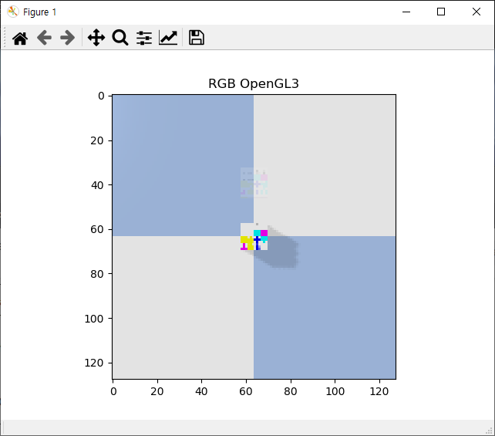
cameraUpVector 비교
p.loadURDF('cube_small.urdf', basePosition=[0.0, 0.0, 0.025])
cube_trans = p.loadURDF('cube_small.urdf', basePosition=[0.0, 0.1, 0.025])
p.changeVisualShape(cube_trans, -1, rgbaColor=[1, 1, 1, 0.1])
view_matrix = p.computeViewMatrix([0, 0, 0.5], [0, 0, 0], [0, 1, 0])

Slide 5
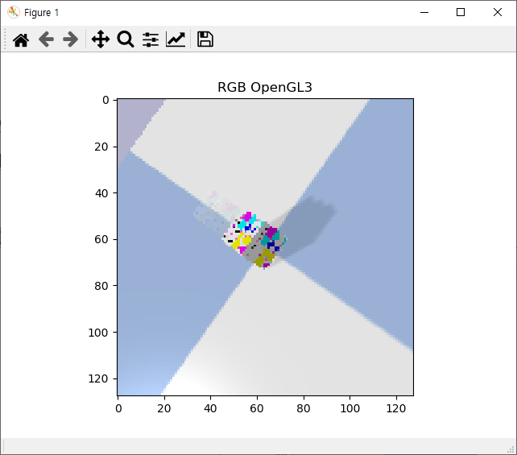
cameraUpVector+ cameraEyePosition 비교
p.loadURDF('cube_small.urdf', basePosition=[0.0, 0.0, 0.025])
cube_trans = p.loadURDF('cube_small.urdf', basePosition=[0.0, 0.1, 0.025])
p.changeVisualShape(cube_trans, -1, rgbaColor=[1, 1, 1, 0.1])
view_matrix = p.computeViewMatrix([0, -0.25, 0.25], [0, 0, 0], [1, 1, 0])

Slide 6
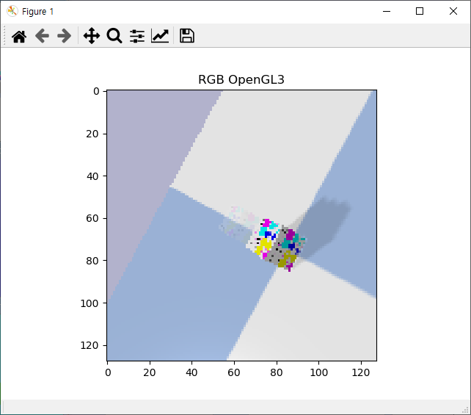
전부 비교
p.loadURDF('cube_small.urdf', basePosition=[0.0, 0.0, 0.025])
cube_trans = p.loadURDF('cube_small.urdf', basePosition=[0.0, 0.1, 0.025])
p.changeVisualShape(cube_trans, -1, rgbaColor=[1, 1, 1, 0.1])
view_matrix = p.computeViewMatrix([0, -0.25, 0.25], [0, 0.1, 0.025], [1, 1, 0])

Slide 7
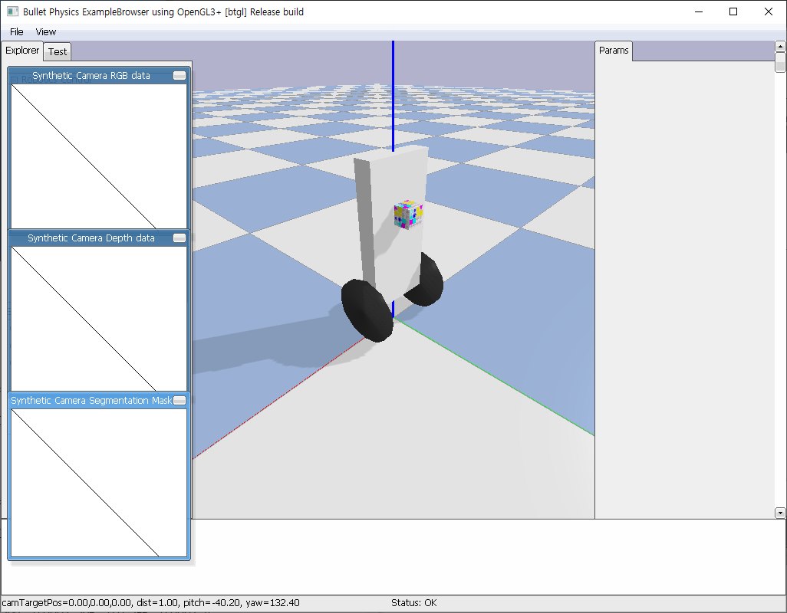
Balancebot_simple.xml
p.loadURDF('cube_small.urdf', [0, 0.05, 0.1+(0.4*2/3)])
Torso 0.2 0.05 0.4
wheel 0.1

Slide 8
응용 1단계
로봇에 카메라 갖다대기

Slide 9
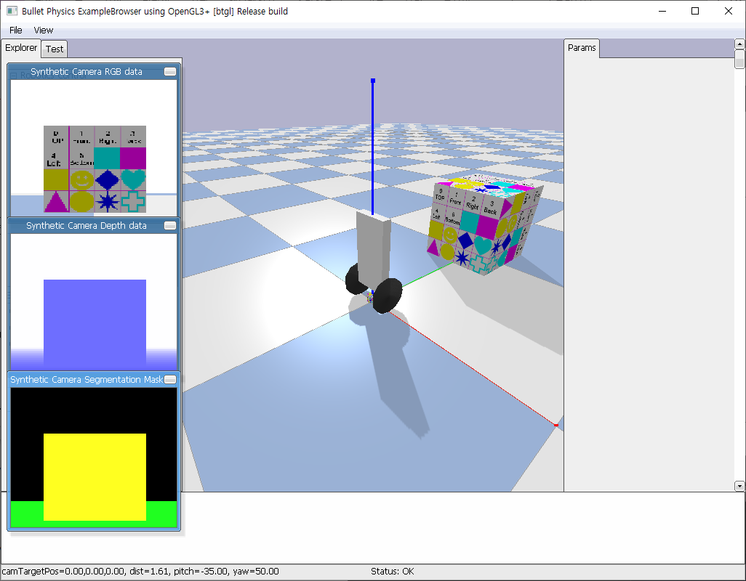
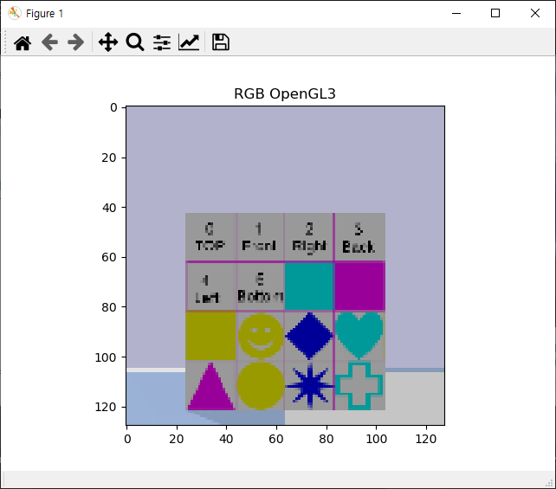
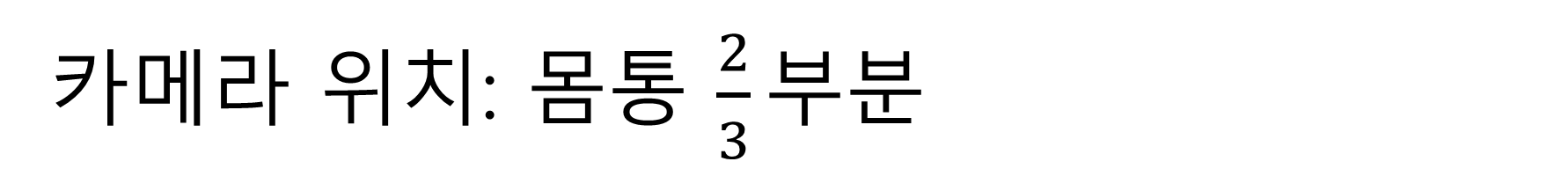
카메라 위치: 몸통 $\frac{2}{3}부$분
balancebot = p.loadURDF(‘D:/Documents/GitHub/balance-bot/balance_bot/envs/balancebot_simple.xml’)
Campos = [0, 0.05, 0.1+(0.4*2/3)]
Cube_trans = p.loadURDF(‘cube_small.urdf’, basePosition=[0.0, 1, 0.025*10], globalScaling=10)
P.changeVisualShape(cube_trans, -1, rgbaColor=[1, 1, 1, 1])
View_matrix = p.computeViewMatrix(campos, [0, 1, 0.1+(0.4*2/3)], [0, 0, 1])

Slide 10
응용 2단계
로봇에 카메라 달아주기

